Slide 1
Vehicle Detection and Counting
Sagar Kumar Ojha- 200301120123
Baisakhi Rani Das-200301120131

Slide 2
AGENDA
Introduction
Objectives
Hardware & Software Specifications
Results
Testing
Validation- Screen recorded video
Conclusion

Slide 3
Introduction
Vehicle detection and Counting in video processing has numerous applications, including traffic monitoring, autonomous driving, and surveillance systems using YOLO v8.
It can help improve road safety, reduce traffic congestion, and enhance transportation efficiency.

Slide 4
Objectives
The main Objective of this project is :
To Detect the Various forms of Vehicles, whether it is Car, Bike, Scotty, Truck, rikshaw, bus from the video.
Counts the no of vehicles.

Slide 5
Hardware & Software Specifications
H/W Requirements:
Processor: Any Processor above 500MHz
RAM: 8.00 GB
Input device: Standard Keyboard and Mouse.
System type: 64-bit operating system, x32-based processor
S/W Requirements:
Operating system: Windows, MacOS or Linux
Programming: GoogleColab and Related library files
Environment: GoogleColab
Microsoft PowerPoint

Slide 6
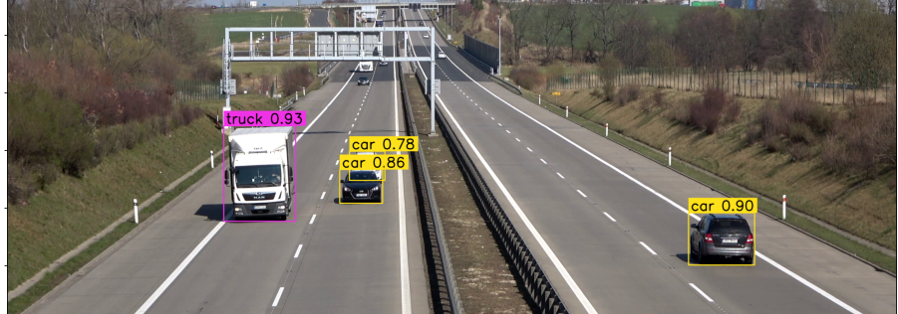
Results
Accuracy: 0.87

Slide 7
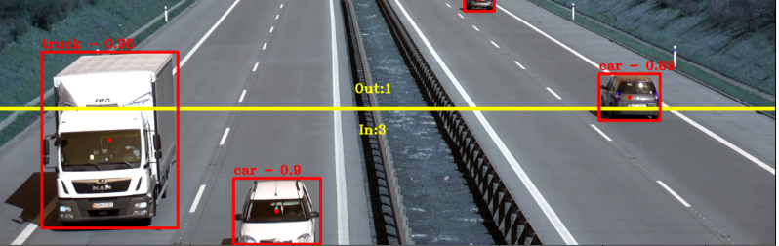
Testing

Slide 8
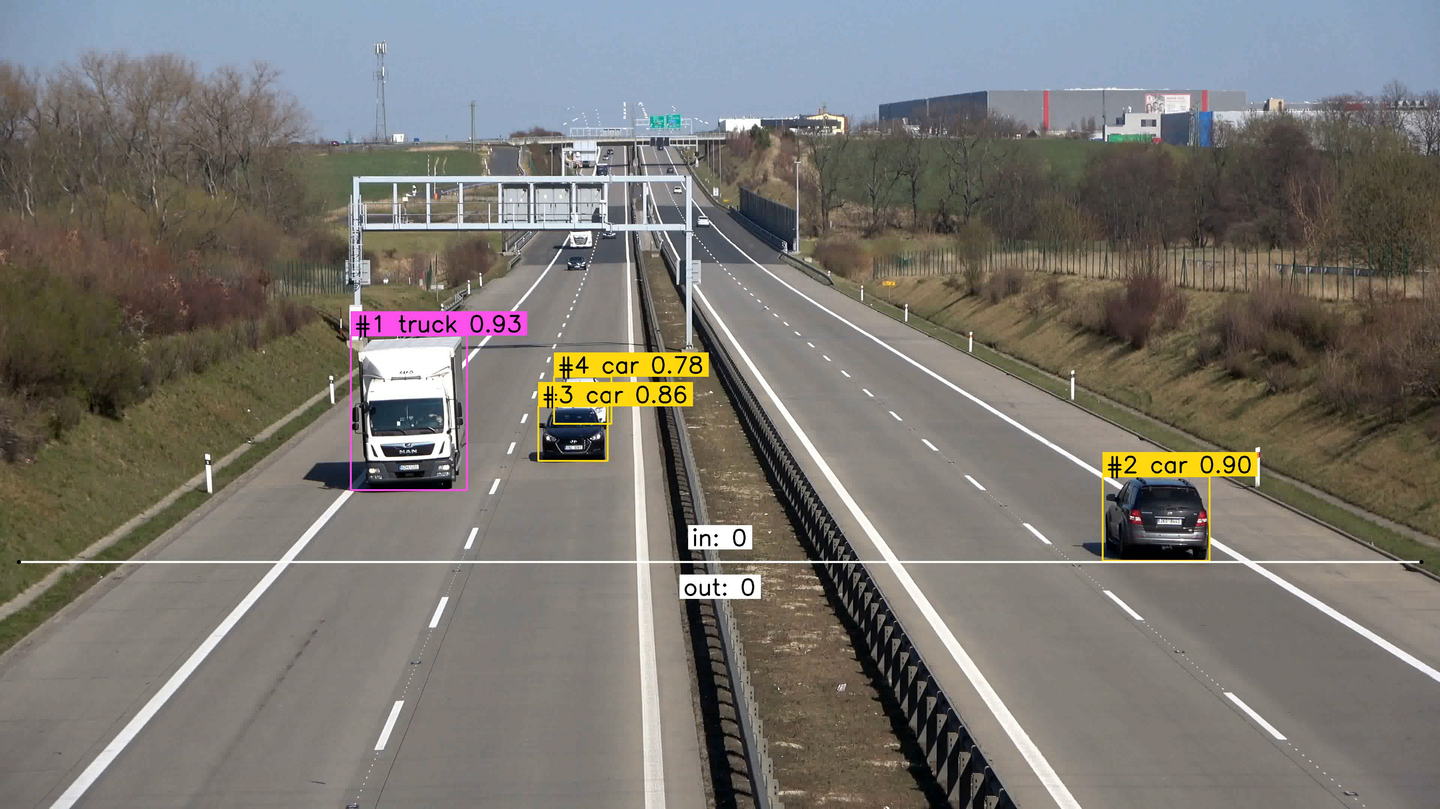
Validation- Screen-recorded video

Slide 9
CONCLUSION
The conclusion of vehicle detection in video processing is that it is a complex and challenging task that requires advanced computer vision techniques and machine learning algorithms.
Vehicle detection aims to identify and locate vehicles in a given video sequence.
Overall, the development of advanced computer vision techniques and machine learning algorithms has greatly improved the accuracy and efficiency of vehicle detection in video processing.

Slide 10
THANK YOU

